Slide 1
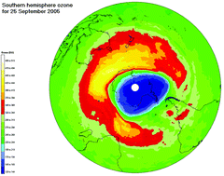
Environmental Effects Of Electricity Generation https://science.nasa.gov/resource/video-global-warming-from-1880-to-2022/

Slide 2


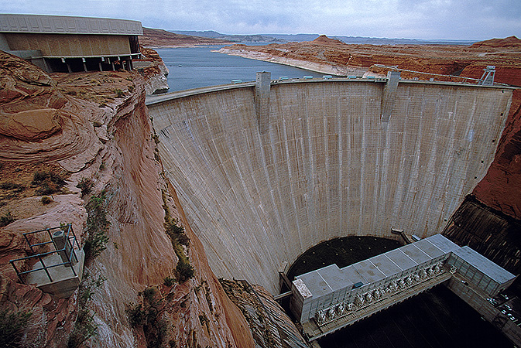
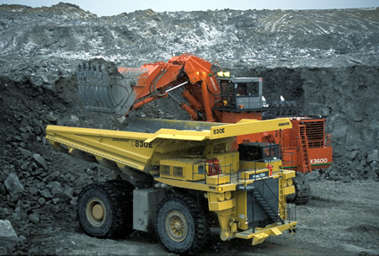

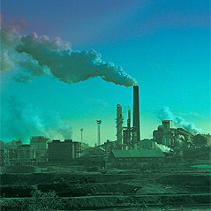
Introduction
Improvement in quality of life for the human race has dramatically changed various parts of the environment:
Agriculture
Building Construction
Canals and Dams
Mining
Transportation
Factories

Slide 3
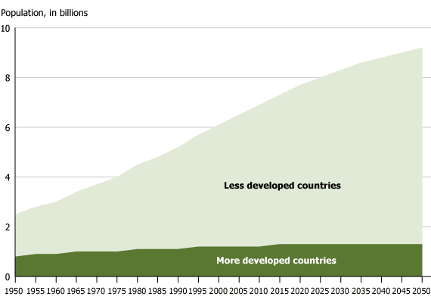
Introduction
Until the 1960’s there was not much consideration for environmental effects
During the 1960’s there was increased awareness of the effects of environmental pollution
US congress:
passed the National Environmental Policy Act (NEPA)
passed the Clean Air and Water Act
created the Environmental Protection Agency (EPA), etc.

Slide 4
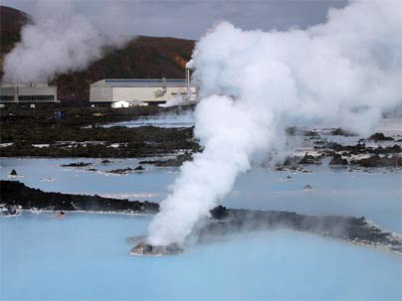
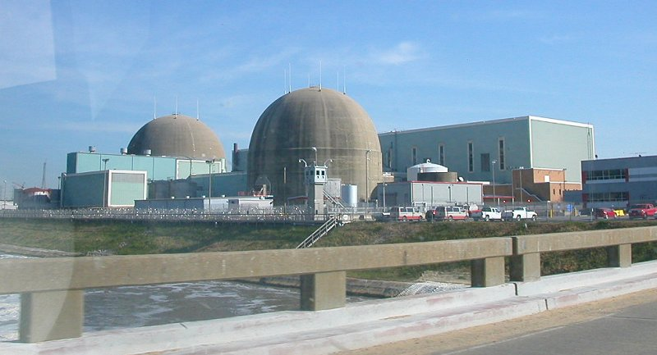
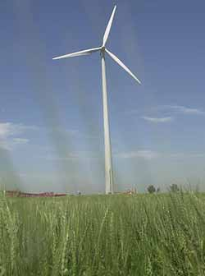
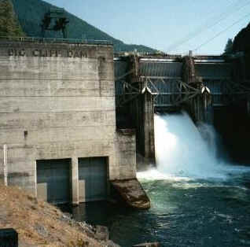
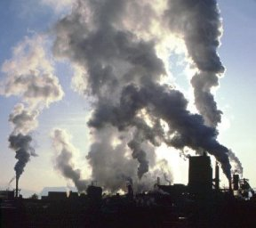
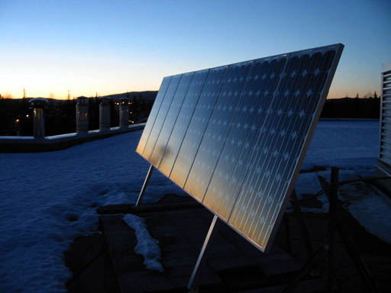
Types of Electrical Generation Leading To Pollution
fossil fuel plants: coal, oil, etc.
hydroelectric power
geothermal power
solar energy
nuclear energy
others: tidal, fusion, wind, etc.

Slide 5
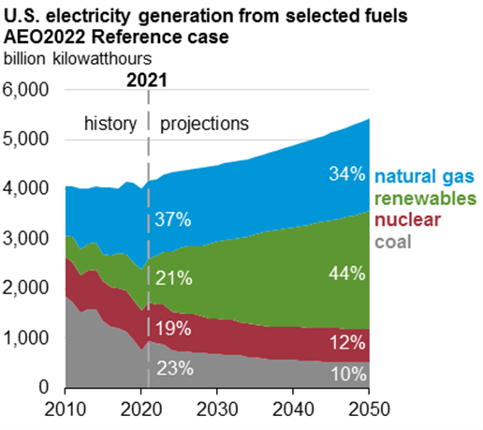
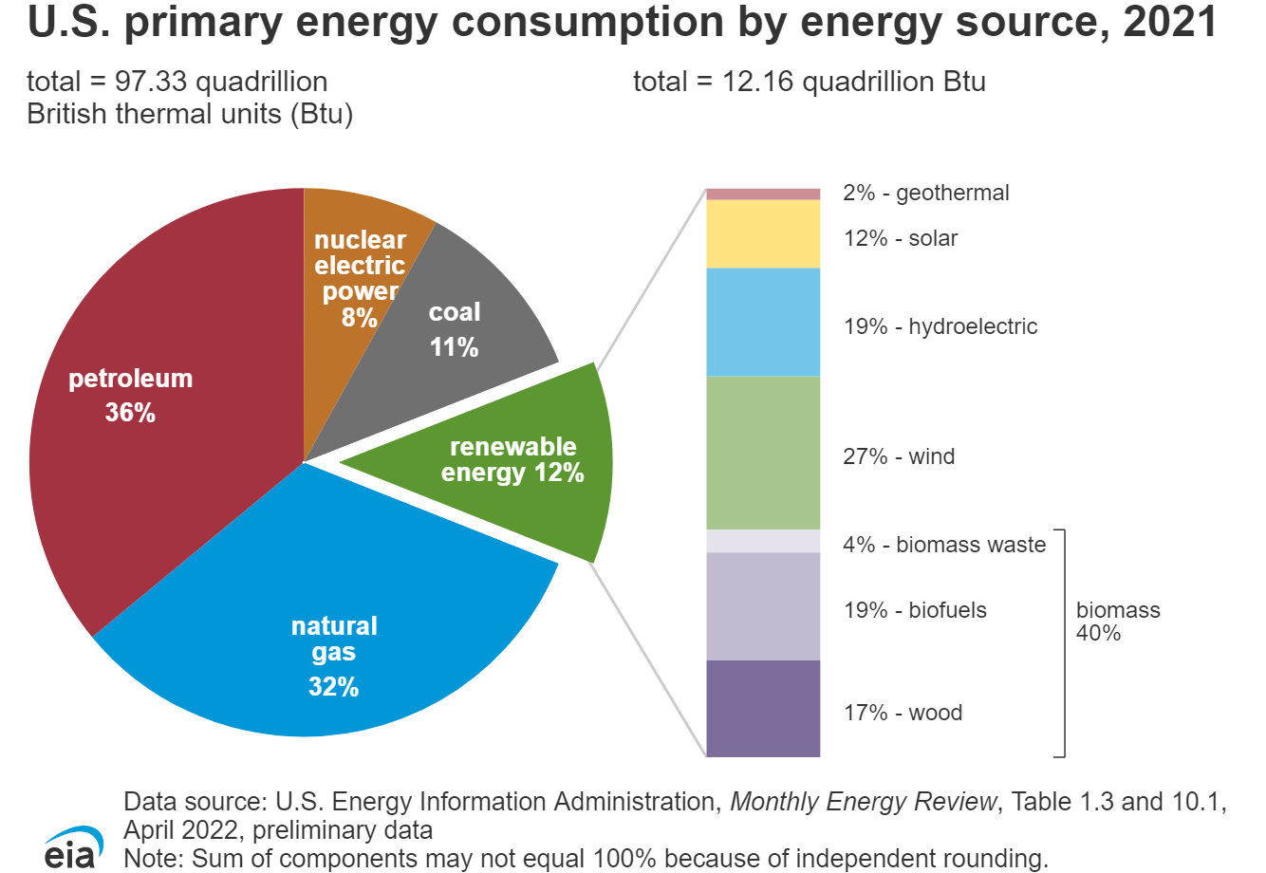
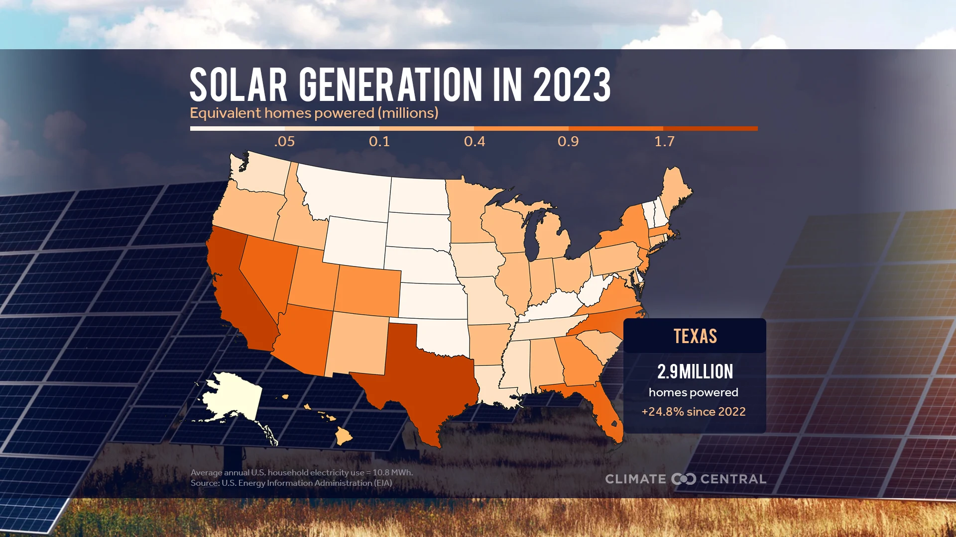
North America: Electric Power Generation and Energy Consumption

Slide 6
FOSSIL FUEL

Slide 7
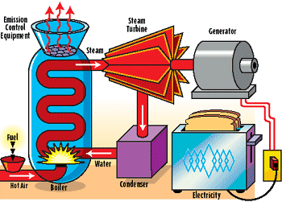
Basic Fossil Fuel Cycle
Fossil fuel is burned in boiler
Water circulating through boiler absorbs heat and is changed into steam
Pressure of steam against the turbine blades spins the shaft and turns generator
Used steam is cooled by the condenser, changed back into water, and pumped back into boiler
Cool water that condenses the steam is drawn from a river, lake, or sea and is discharged back at a slightly higher temperature

Slide 8
Fossil Fuel Plants
Major environmental effects are release of:
fly ash
carbon dioxide
nitrogen oxide
sulfur dioxide
heavy metals such as arsenic, selenium, lead, mercury, etc.
There are also risk factors associated with the exploration, gathering, handling, and transportation of fossil fuels (e.g. EXXON Valdez and BP oil spills)

Slide 9
Quantities of Waste Products from a 1000 MW Fossil Fuel Plant

Slide 10
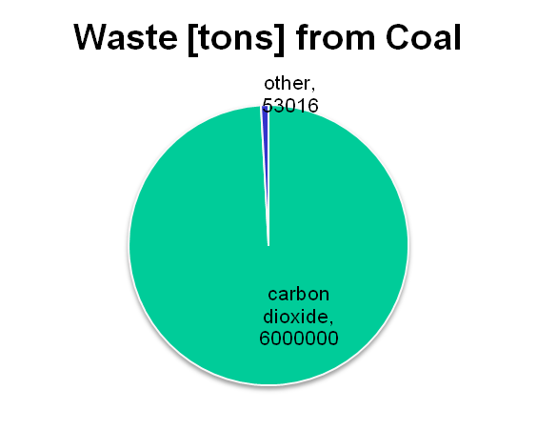
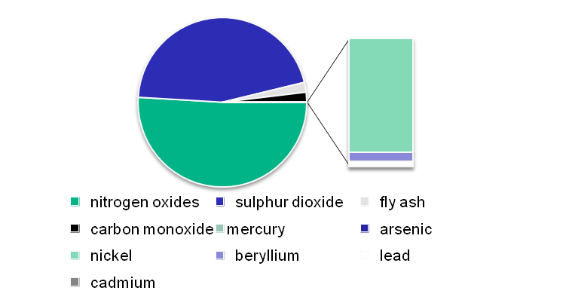
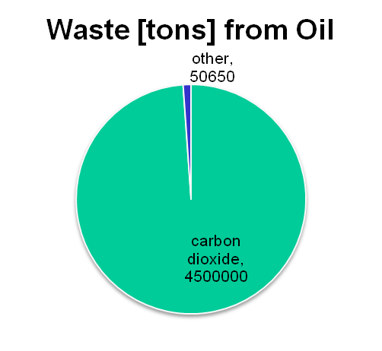
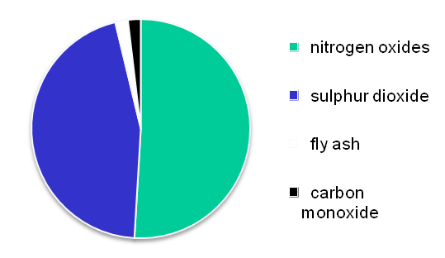
Annual Atmospheric Discharges from a 1000 MW Fossil-Fuel Plant

Slide 11
Risks Resulting From the Operation of a Coal-Fired Power Plant

Slide 12
GLOBAL WARMING

Slide 13
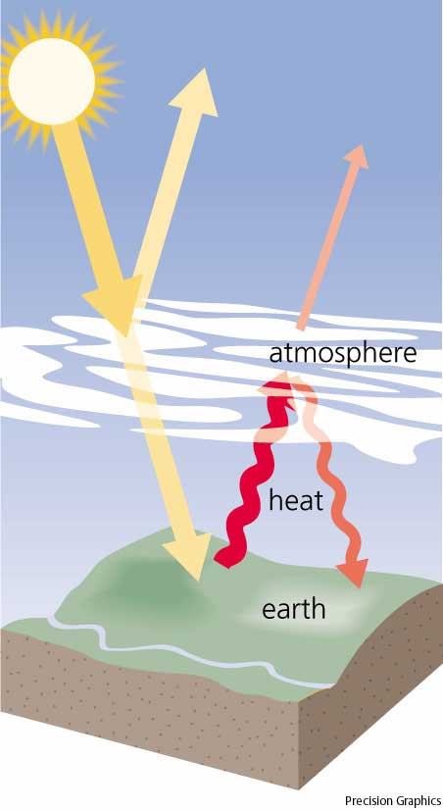
Greenhouse Effect
The ‘greenhouse effect’ is used to describe the potential change of the earth’s atmosphere as a result of changes in the atmosphere
Ideally the atmosphere of the earth allows the heat of the sun to reach the planet and retains the earth’s heat in such a way that the temperature of the planet stays about constant

Slide 14

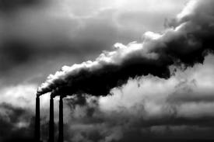
Global Warming: Why All the Fuss?
life has prospered on planet Earth for nearly 4 billion years
there have been drastic climate fluctuations in cold and heat
living species have benefited and flourished, others adapted, faltered or died

Slide 15


what does it really mean a 1 - 4° (c) rise in world temperature?
should we be concerned?
are we over-reacting?
can we control it?
who can we believe?
who can we trust?
is the science valid?

Slide 16
What is the Greenhouse Effect ?
without the atmosphere the average temp. would be
-18º C or - 0.4º F
currently with our atmosphere the average temp. is
15º C or 59º F
the incoming sunlight gives about 300 W per square yard
without the atmosphere, the heat would hit the earth and bounce back into space

Slide 17
with the atmosphere, the heat is trapped by water vapor, CO₂, methane (CH₄), and others
as those gases heat up  some of the their warmth radiates back down to the surface
the entire process is called the greenhouse effect with the most predominant greenhouse gas being water vapor

Slide 18
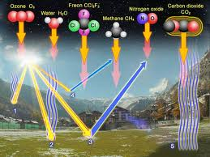
with increased heating  more water vapor evaporates from oceans, lakes, and soils.
because a warmer atmosphere can hold more water  a powerful feedback loop is created
the hotter it gets  the higher the water vapor content and thus the greater the greenhouse effect

Slide 19
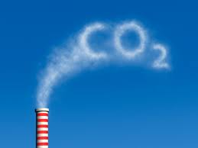
Greenhouse Gases
CARBON DIOXIDE
carbon dioxide levels also produce an increased greenhouse effect
this gas continues to increase in concentration in our atmosphere.
most of the increase in CO₂ is attributed to fossil fuel burning since 1850’s
CO₂ has increased 0.3% per year and is now 30% higher than the 1850’s (beginning of the industrial period)

Slide 20
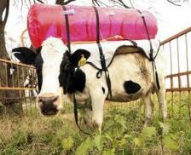
METHANE
methane, principal ingredient of natural gas, has caused about a 15% increase of global warming
CH₄ is generated by bacteria in rice fields, decomposing garbage, cattle, sheep and goat ranching, and fossil fuel production
methane persists in the atmosphere for more than a decade

Slide 21

Other Greenhouse Gases Include:
nitrous oxide
released from chemical fertilizers and fossil fuels
CFC’s (cholorfluorocarbons)
this refrigerant is now banned by international agreement

Slide 22
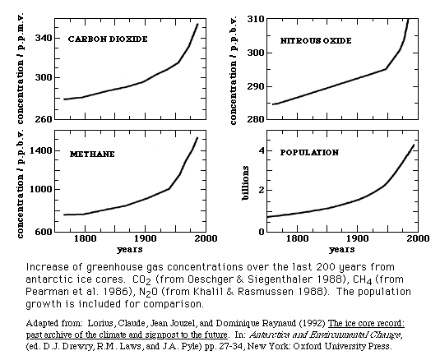
Global Changes in Greenhouse Gases

Slide 23
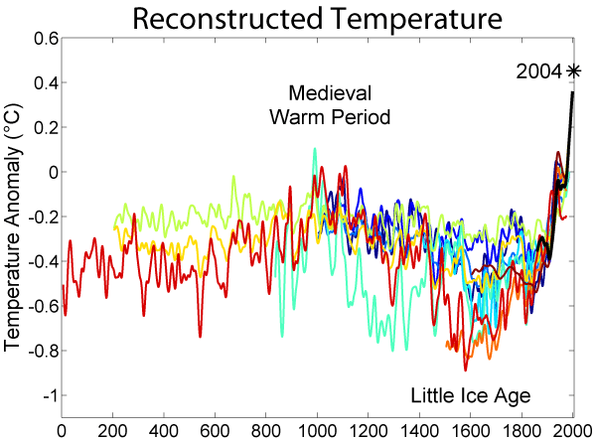
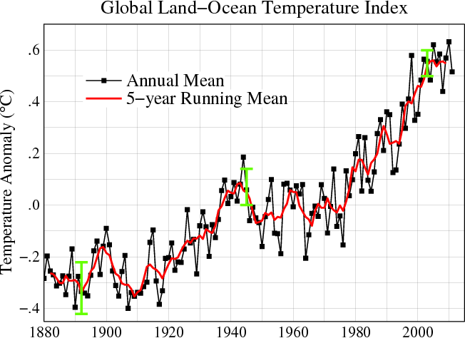
Global Changes in Temperature

Slide 24
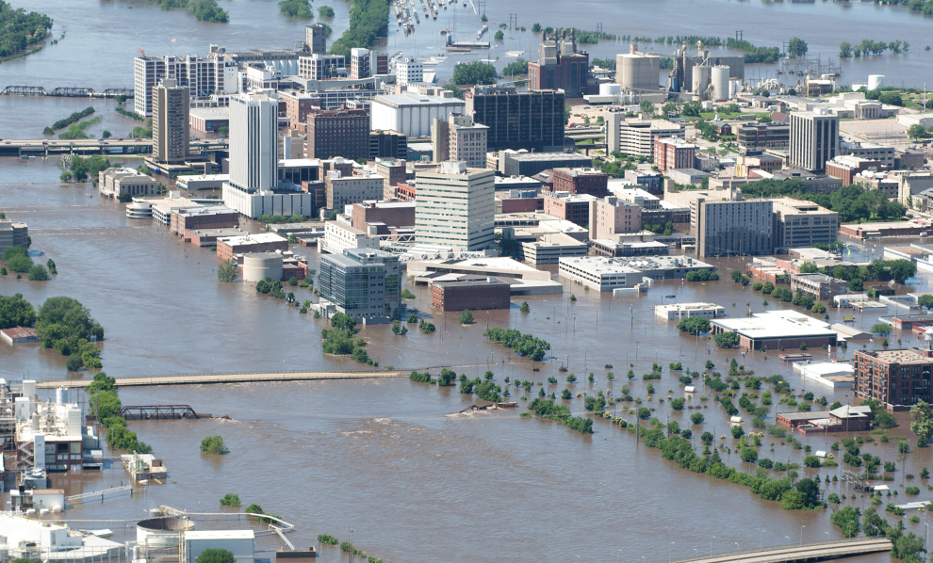
Global Warming Effects

Slide 25
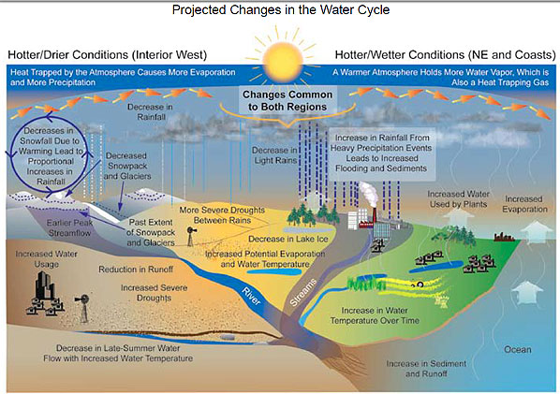

Slide 26
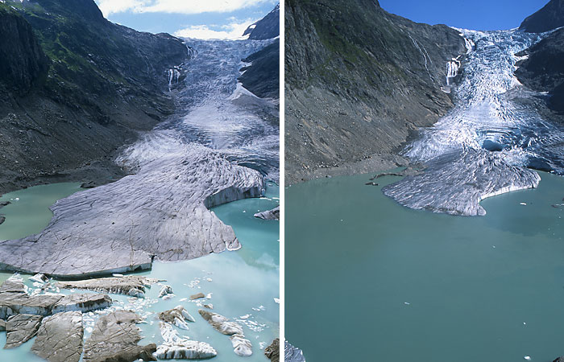
Glacier Recession

Slide 27
The Carbon Dioxide Cycle
oceans serve as a vast “sink” for CO_{2.}
human activity adds 7 billion tons to the atmosphere which already has 750 billion tons (only ~ 1%)
3 billion tons remain in the air and the rest is taken up by terrestrial and marine plants, buried in ocean sediments, absorbed in seawater, or otherwise sequestered

Slide 28
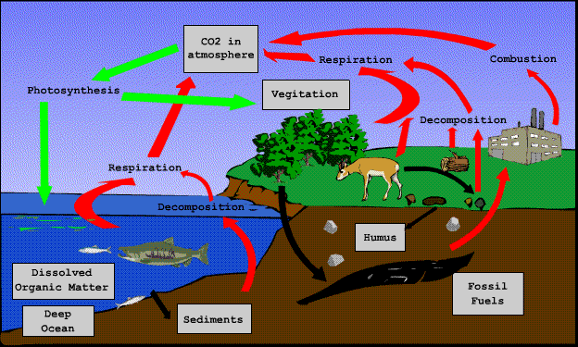
of the “missing” carbon dioxide  the oceans apparently remove at least 2 billion tons.
there are ~ 35 trillion tons of CO₂ in the oceans
so why does an additional 7 billion tons of carbon dioxide create global warming?
natural processes are in balance drawing as much CO₂ from the air as they deposit

Slide 29
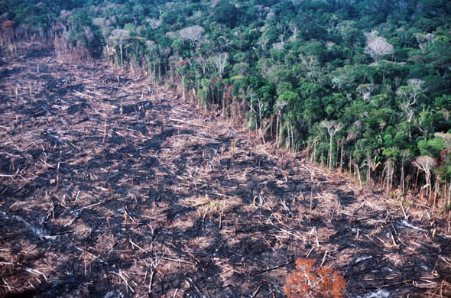
major users of CO₂ are forests and rain forest.
as deforestation occurs  the problem is compounded
since some of the burnt land is used for cattle ranching which produces CH_{4.}

Slide 30
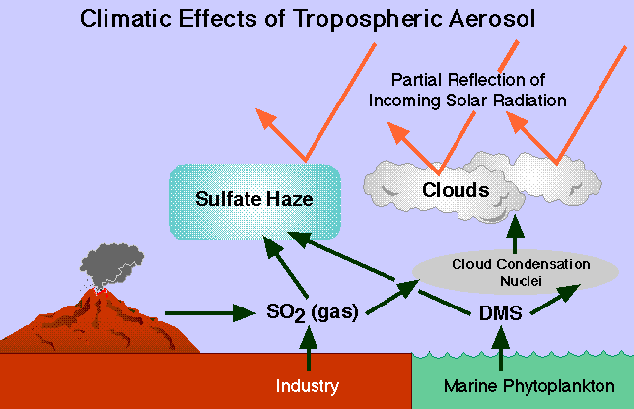

Slide 31
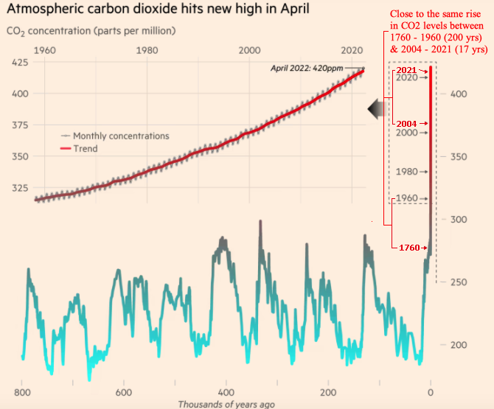
Increase in Atmospheric CO₂ Between 1960 - 2020

Slide 32
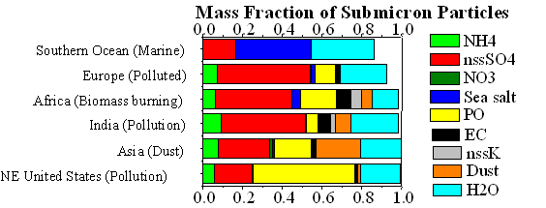
Aerosols
what are aerosols?
where do they come from?
what size are they?
why are they important in climatic change?
what are the effects?
can we control the amount of aerosols entering the atmosphere?
and if so, how?

Slide 33
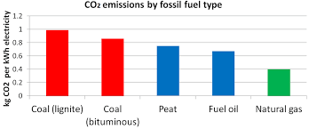
Carbon Dioxide Emission by Fuel Type

Slide 34
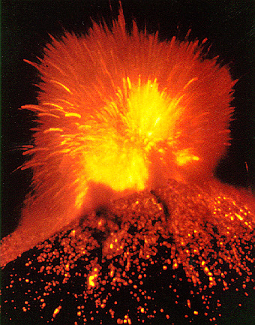
Acid Rain
Acid Rain comes from nitrogen oxide and sulfur dioxide
It has different pH levels.
on a scale from 0 – 14, normal is 7, the most acidic is 0 and the most basic is 14.
on a pH scale, 5 is 10 times more ACIDIC than 6
Natural gases such as volcano eruptions can cause acid rain

Slide 35
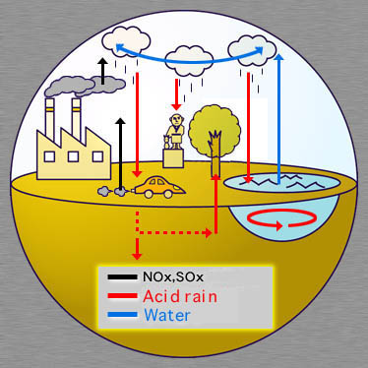
Acid Rain
Most acid rain comes from car exhaust and the burning of coal
The process of coal burning is:
S (in coal)+ O₂  So₂ + 2 So₂ + O₂  2 SO₃  SO₃ + H₂O  H₂SO_{4.}
Car exhaust process is:
N₂ + O₂  2NO
2NO + O₂  2NO₂
NO₂ + OH  HNO₃

Slide 36
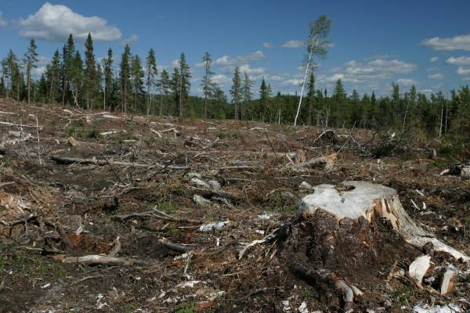
Acid Rain
Acid rain damages soil, poisons lakes and rivers, and harms trees (DEFORESTATION)
It can destroy the ecosystem: fish, plants, insects, and harm anything that eats or drinks from the acidic waters
There are several ways that acid rain can enter the water 
as dry particles in the air
as wet particles such as rain, snow, sleet, hail, dew, or fog

Slide 37

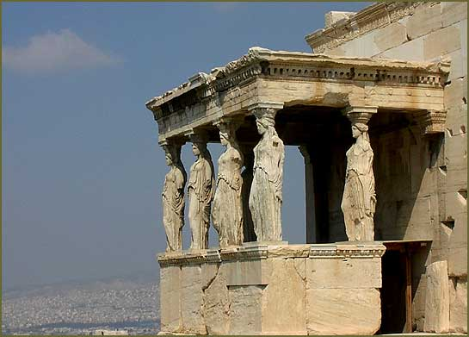
Acid Rain
Respiratory problems may also arise from inhalation of fine acid particles
Acid rain can also be very damaging to buildings and old statues

Slide 38
RENEWABLES

Slide 39
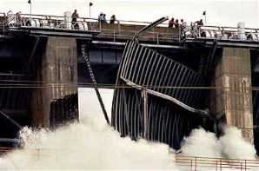
Hydroelectric Power
Hydroelectric power supplies about 6% of US total needs
This might be much higher in other countries
Environmental effects include local ecological changes due to dam building, and effects resulting from catastrophic dam failures
Country | Hydroelectricity production (TWhr) | % of total capacity
China | 652.05 | 22.25
Canada | 369.5 | 61.12
Brazil | 363.8 | 85.56
United States | 250.6 | 5.74
Russia | 167 | 17.64
Norway | 140.5 | 98.25
India | 115.6 | 15.8
Venezuela | 85.96 | 69.2
Japan | 69.2 | 7.21
Sweden | 65.5 | 44.34

Slide 40
Recent Dam Failures & Resulting Fatalities

Slide 41
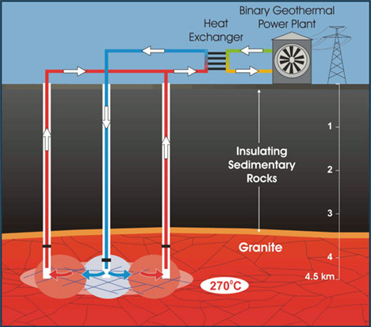
Geothermal Power
Geothermal energy is the heat inside the earth found in many forms:
as dry steam
hot water
hot dry rock
Only in parts of the western US are the economic conditions favorable  less than 1% of the total US energy needs would be met
On a local level geothermal power results in noise and air pollution from:
Hydrogen sulphide, ammonia, and other effluents
pollution of groundwater from wastes

Slide 42
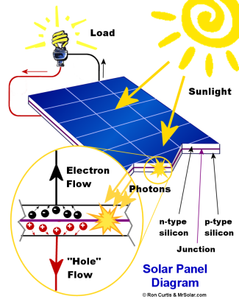
Solar Energy
Solar energy can be used to heat and cool down buildings but generation of electricity is far more complex
Environmental effects include:
ecological local effect due to the size of land needed
for every 1000 MW plant some 16–20 square miles is needed
need for materials such as photovoltaic cells that require large amounts of silicon

Slide 43
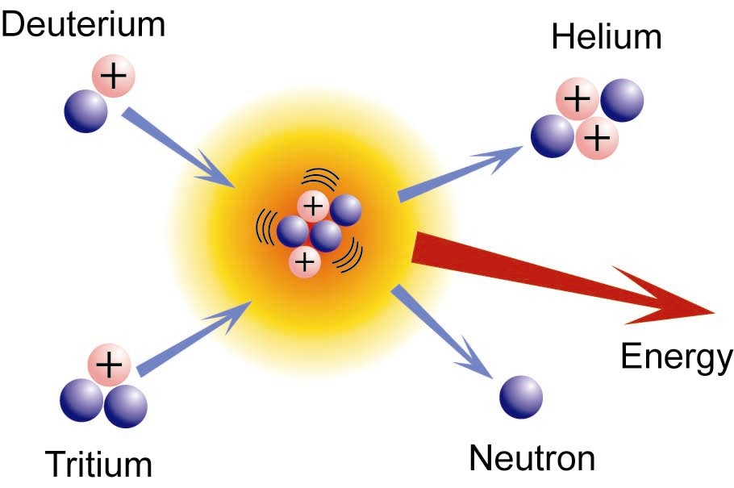
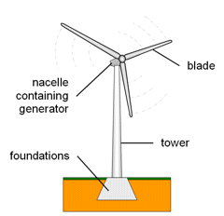
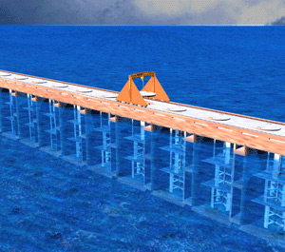
Less Developed Potential Electric Power Sources
Tidal
not always deemed economical
Wind
windmills take up large areas of land, generate noise, and have the potential for the breakup of the mill which act like projectiles
Fusion
large generation of tritium

Slide 44
NUCLEAR POWER

Slide 45
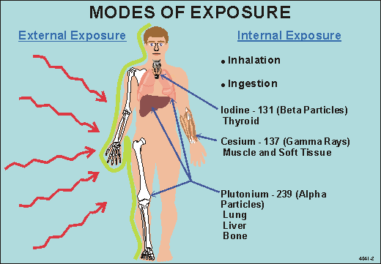

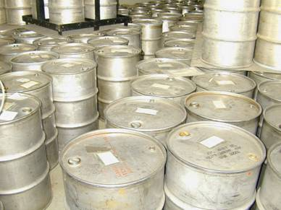
Nuclear Power Plants
Produces about 20% of US electric power
Environmental effects include:
wastes from uranium mining and disposal
radiation exposure to workers and the public during normal operations
radioactive waste management

Slide 46
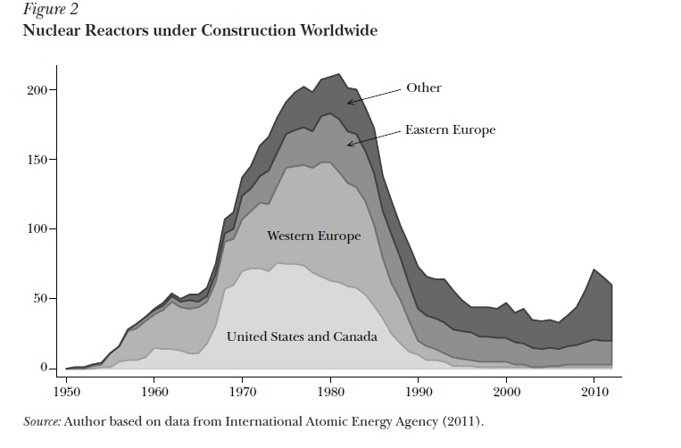
Development of Nuclear Generating Capacity

Slide 47
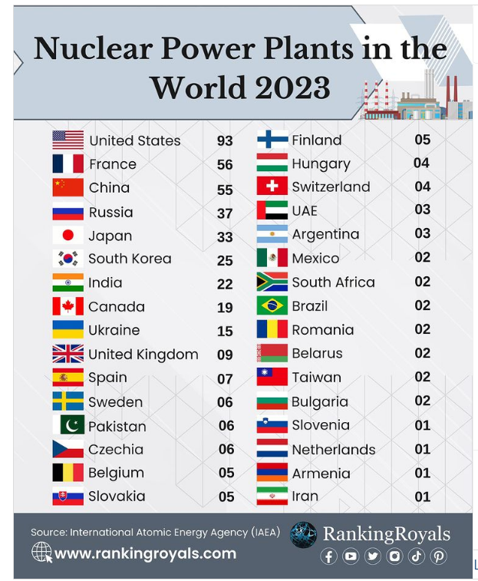

Development of Nuclear Generating Capacity
Number of nuclear reactors under construction worldwide as of July 2024

Slide 48
Comparison of Population Radiation Doses from a Coal-Fired & Nuclear 1000 MW Power Plant
a – at the plant boundary, to be 500 m from the point of release
b – out to 55 mi. for a Midwestern site assumed to have a population of 3.5
million within that radius
c – assuming ash release of 1% & coal containing 1 ppm U and 2 ppm Th

Slide 49

Frequency Of Natural Event With Fatalities > N Compared to Estimated Fatalities From The Operation Of 100 Nuclear Power Plants

Slide 50
Comparison of Effluents From Various Types of 1000 MW Power Stations
a - 30 tons of nuclear fuel is a round no. needed to refuel 1/3 of the core/yr. - only a fraction of this fuel is actually consumed.

Slide 51
Some Conclusions
Energy diversification is a very fast changing technological environment with many competing sectors
e.g. oil sands, battery storage capacity, smart grid technology, biofuels, hydraulic fracturing (fracking) for natural gas…………..
Energy independence remains a high priority for a global rise in the standard of living
There is no single “magic bullet” that can answer all the ever growing energy needs
New energy intensive markets such as Brazil, Russia, India and China makes the need for a world wide energy strategy

